Slide 1
LESSON PLAN (eRPH) WEB APPLICATION

Slide 2
INTRODUCTION
A lesson plan is a detailed guide created by teachers to outline the structure and content of a lesson. It serves as a roadmap for what students need to learn, how the lesson will be taught, and how learning will be assessed.
Usually, lesson plans are using paper and pen. My Lesson Plan Web App will help solve some issues related to traditional lesson plans such as paper and storage, accessibility, updates, modification, and tracking and analysis.

Slide 3
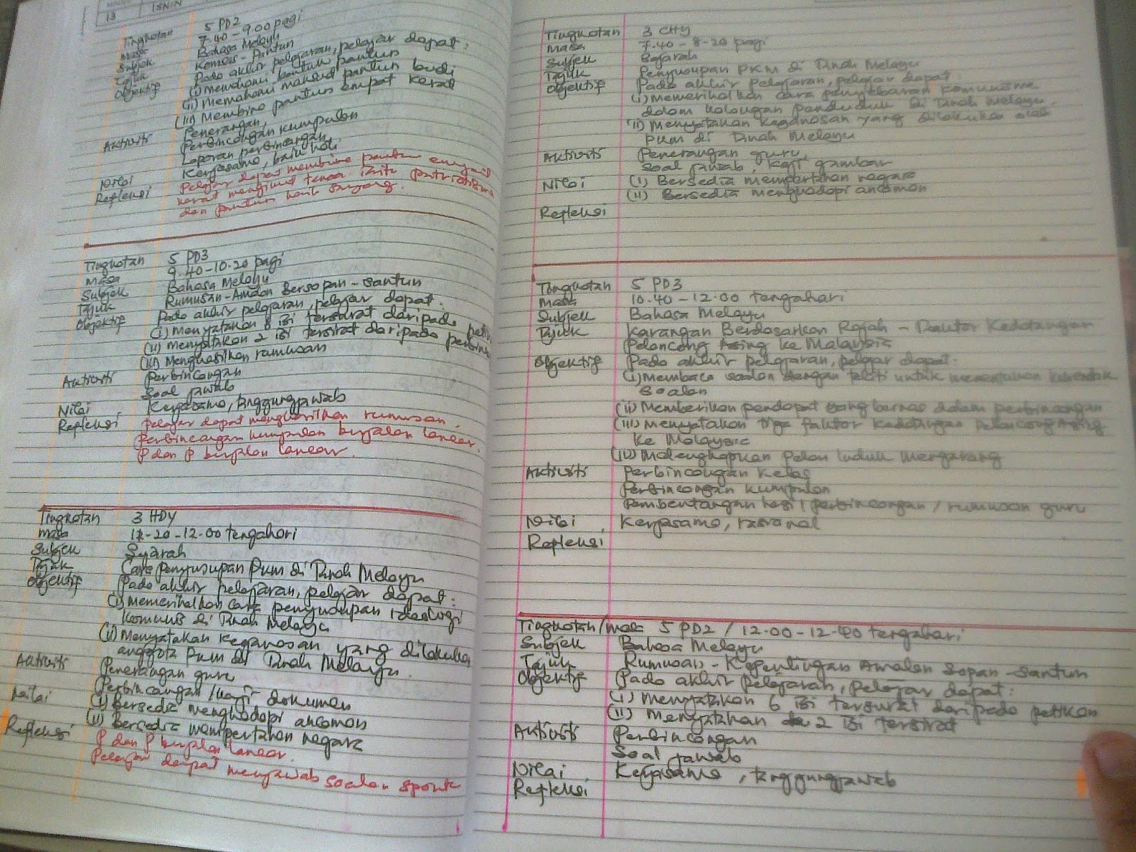

Slide 4
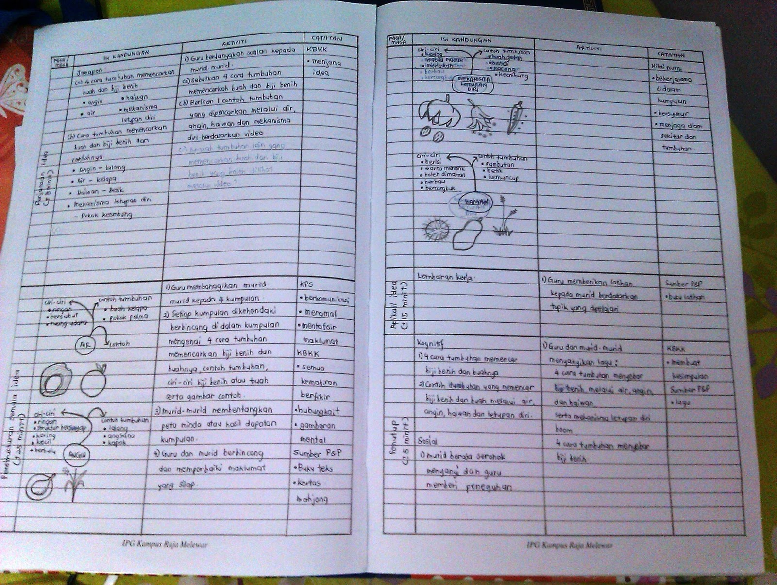

Slide 5
FEATURES
User authentication and authorization – Allow users to register and log in using email and password. Define roles such as admin and teacher. Admin have full access while teacher can manage their lesson plan.
Dashboard – Display dashboard for each role, i.e. admin, teacher. Admin can overview of all activities while teachers can see their lesson plan and upcoming task.
Lesson plan management – CRUD operation. Can create lesson plan, read, update and delete if necessary.

Slide 6
FEATURES
Search and Filter – Filter by subject, class and week
Simple analysis – admin can do simple analysis such as rate of submission.

Slide 7
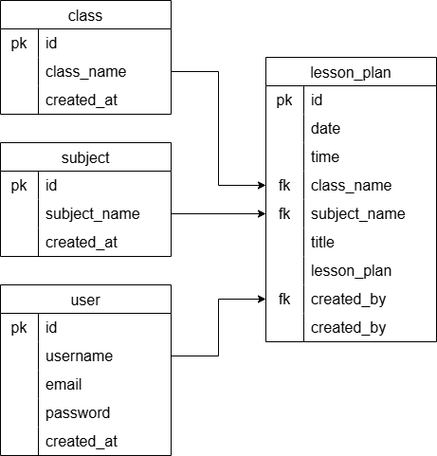
ERD
role

